Slide 1
Housing Data Correlated to Automobile Accidents
Bobby Meyer
Mica Haney
Jacob Harris

Slide 2
Overview
Data Introduction - Bobby Meyer
Correlation of Car Crashes to House Prices - Jacob Harris
Correlation of Car Crashes to Office Buildings - Mica Haney

Slide 3
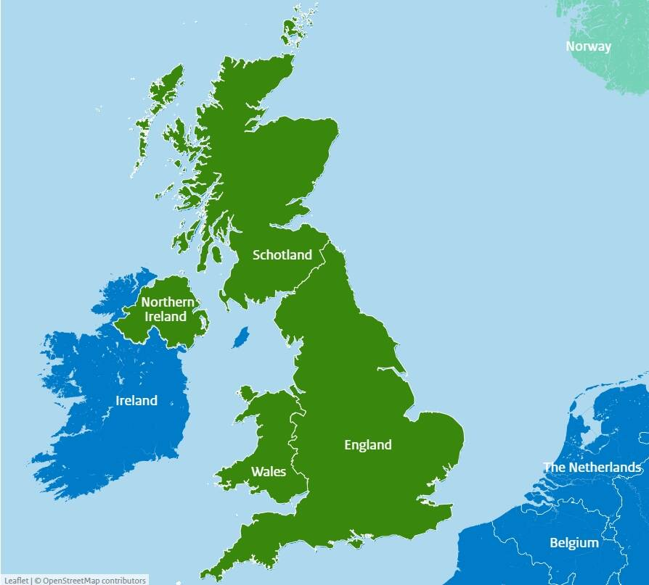
Datasets
Car Crashes in the UK
Housing Prices Paid in the UK
Building Locations
Image1: UK

Slide 4
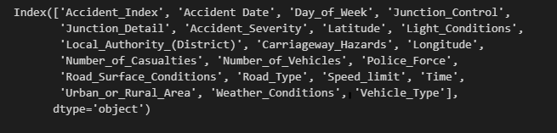
Road Accident Data
Noteworthy Columns
Day of Week
Junction Detail
Latitude
Longitude
Weather Conditions
Vehicle Type

Slide 5
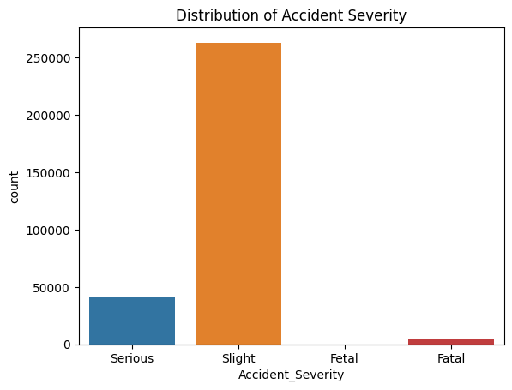
Road Accident Cont.
Overall accidents are ‘slight’ but some are listed as serious and fatal.

Slide 6
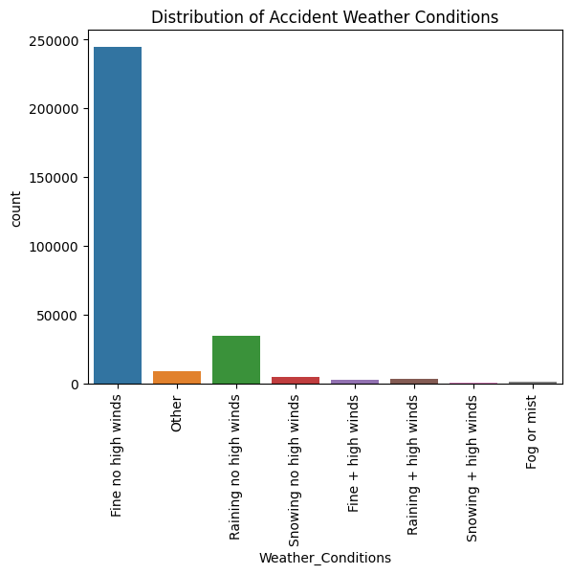
Weather Conditions
This is the UK so weather is a major factor.
Predominantly wet of some factor or it is clear.
Driving in the weather is difficult for anyone.

Slide 7
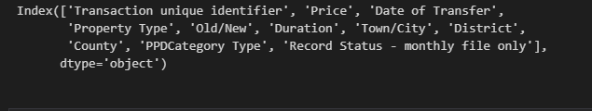
Price Paid for Houses
Noteworthy Columns:
Price
County
Town/City

Slide 8
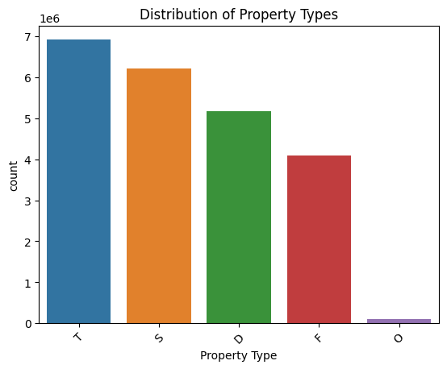
Price Paid for Houses

Slide 9
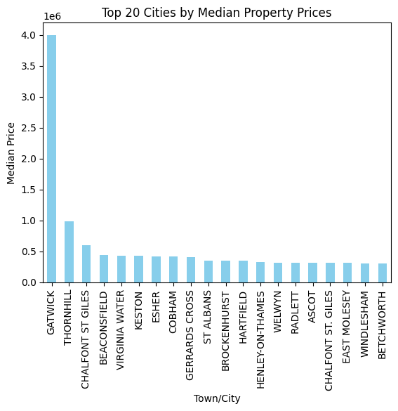
Price Paid for Houses
More expensive housing can lead to more crashes - or less?

Slide 10
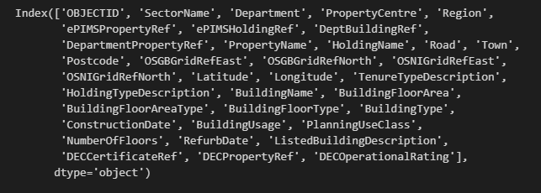
Building Location & Types
Noteworthy Columns:
Department
Property Centre
Region

Slide 11
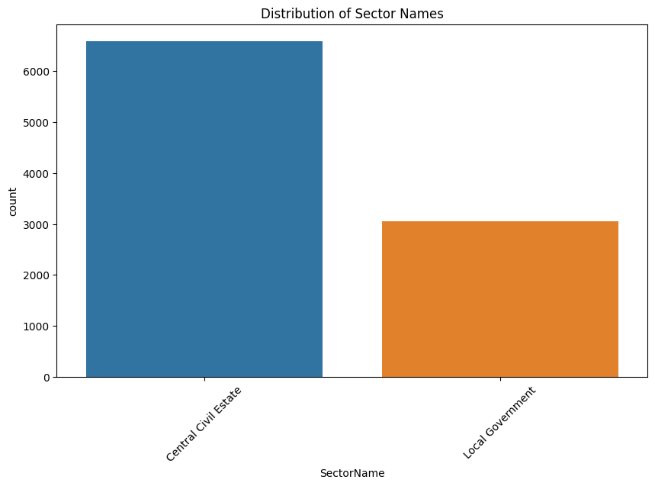
Building Locations
Does higher density of civil or local government lead to more crashes?

Slide 12
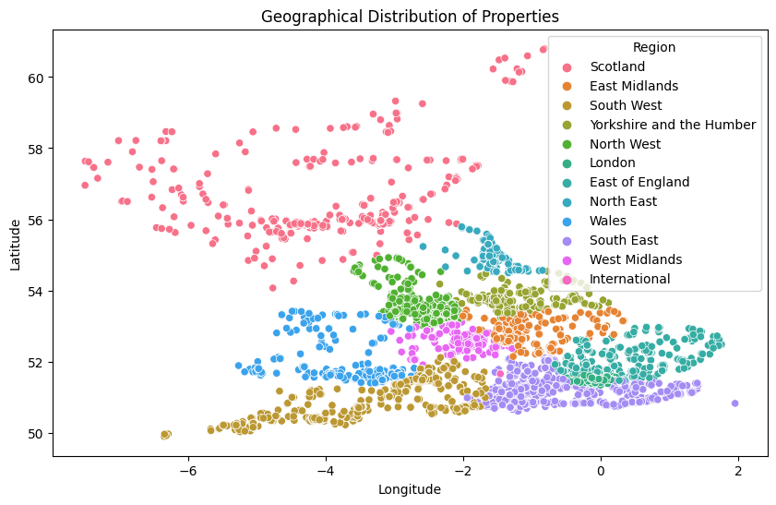
Building Locations

Slide 14

What is the correlation between house prices and crash data?
Jacob Harris

Slide 15
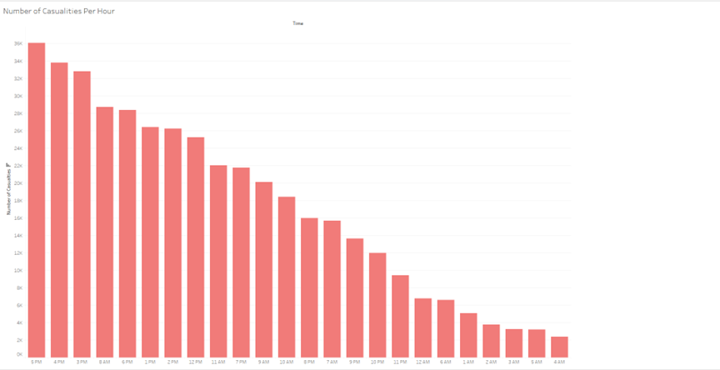
Number of Casualties that occurred, per hour
Starting with our analysis on crash data, our Tableau descending bar chart to the left shows us that accidents peaked at 5 PM, with around 36K total accidents occurring at that time. That is relatively intuitive conclusion, since most people are driving home from work at that time.

Slide 16
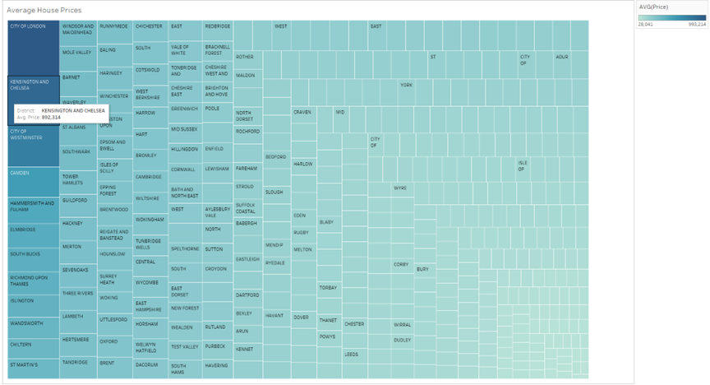
Average Housing Prices Across the UK
Next, we start examining housing prices. The Tableau treemap above average price density; the darker districts have a higher average price than those with less hue. By hovering over each rectangle, you can see the district name and the average house price.

Slide 17
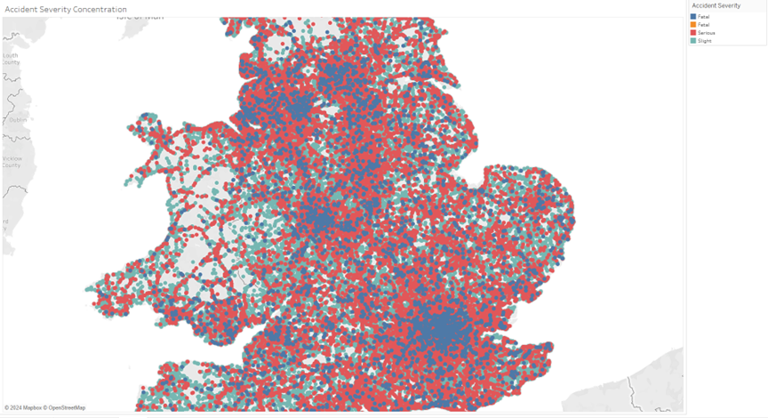
Clusters of Accident Severity
To understand housing prices compared against car crashes, a cluster map of the UK has been created. There are clusters of fatal, serious, and slight, detailing the level of accident, and fetal, whether or not a child was involved. This assists is targeting the areas that have the most accidents, typically occurring in population-dense areas.

Slide 18
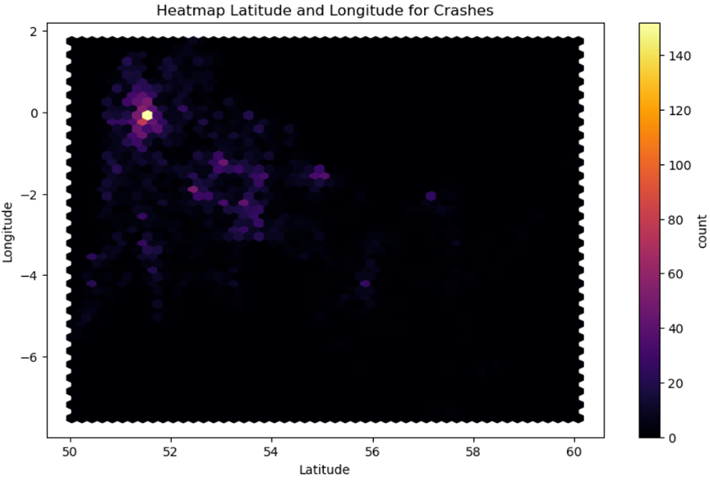
Longitude and Latitude Crash Heatmap
It is important to highlight areas where the most crashes are occurring. To the right is heatmap created in Jupyter Notebook, comparing longitudinal and latitudinal coordinates of car crashes. In the top left corner, the price spot represents the coordinates in and around London.

Slide 19
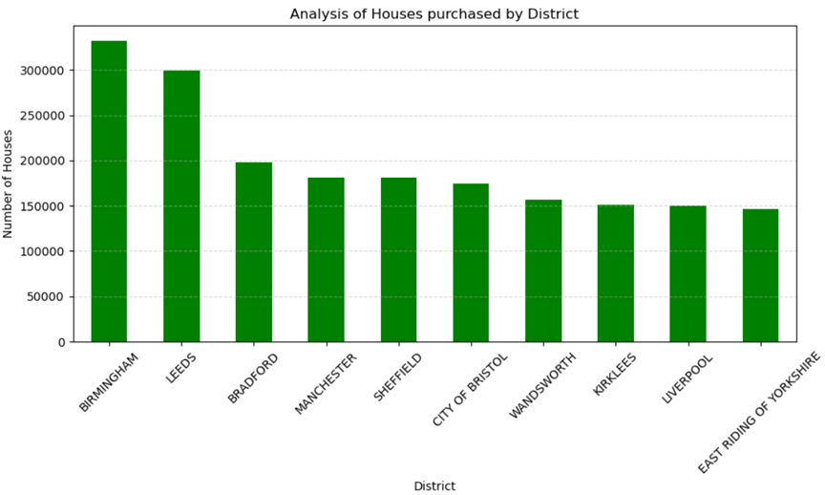
Houses Purchased, by District
As you can see to the left, London has the strongest concentration of houses purchased, with districts such as Birmingham and Leeds having had the most purchased home. With both car crash locational data and house purchases have shown is that they are generally concentrated in the same area. Higher population means larger problem.

Slide 20
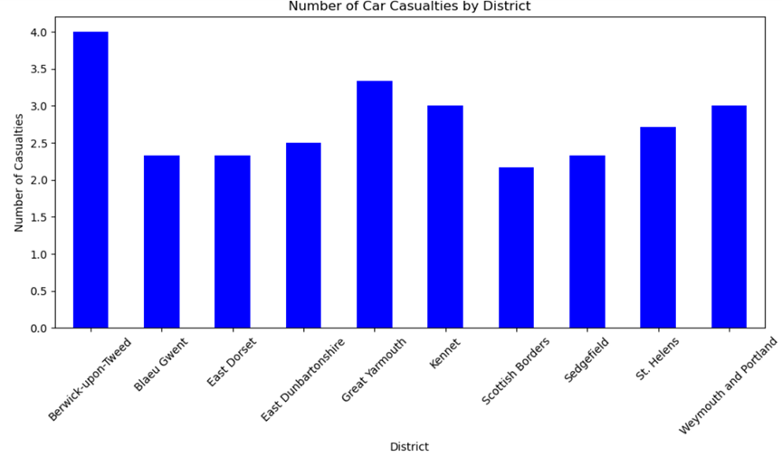
Top 10 Highest Average Vehicle Casualty Rate, by District
It is important to make the correlation between house location and accident location. To the right, a bar chart displaying the 10 districts with highest average casualty rate. An interesting note here is that our major districts seem to be missing. One possible theory to investigate is whether there are more casualties in rural crashes because people drive solo in the city more frequently than urban areas.

Slide 21
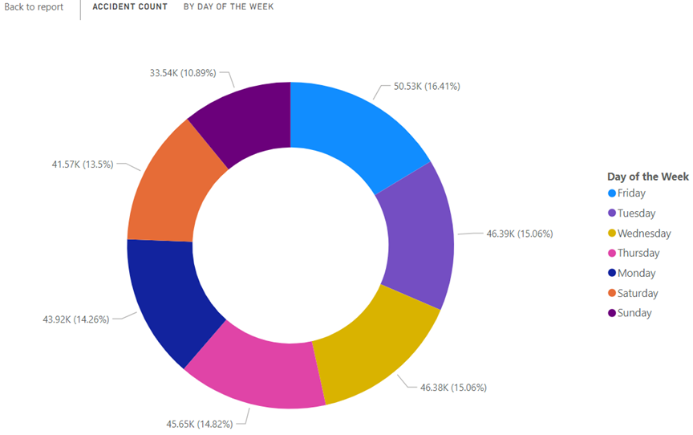
Vehicle Accident Count by Weekdays
We can also highlight, not only when it is most dangerous to travel, by location and time, but also by day. As can be seen in the PowerBI pie chart to the left, most of the middle of the week is about average, with Friday having the most accidents and Tuesday having the least number of accidents.

Slide 22
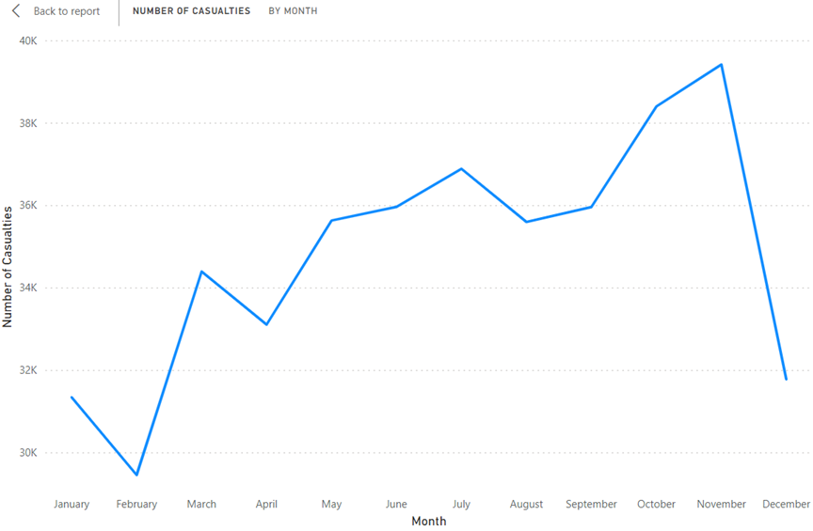
Number of Casualties by Month
It is important to remember that travel during certain parts of the year can be more dangerous. As seen in the PowerBI line chart to the right, the highest number of casualties occurred in October and November. Maybe people consider alternate transportation when travelling during those months.

Slide 23
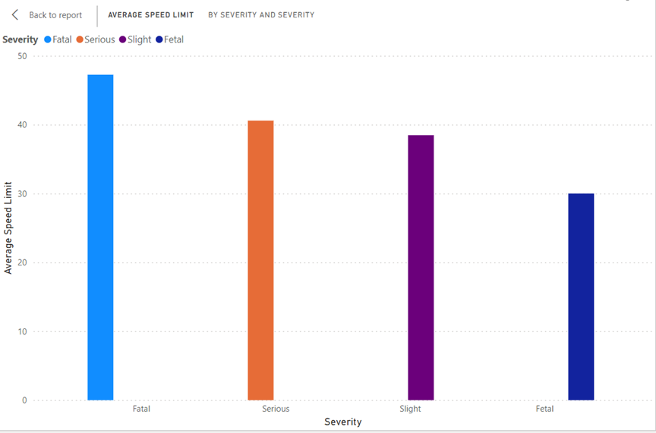
Average Speed, by Severity of Crash
Speed plays an important factor, in regard to accident contribution. As you can see with the PowerBI clustered column on the left, the highest average accident speed occurs in fatal accidents, then trends downward towards serious, then slight, then fetal. The average fatal crash occurred when the driver was going almost 20 mph faster than the average fetal crash speed.

Slide 25
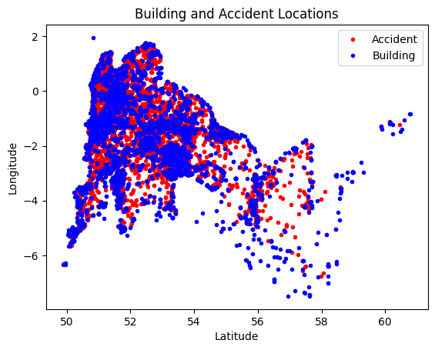
Crashes Relative to Government Building Locations
Next, we examine the relative locations of crashes against the location of government buildings. The above visualization plots the location of each recorded accident as well as each government building location. Due to processing power restrictions, this section of the analysis took a sample of 10,000 records of car crashes in order to run. The samples were randomly selected and should follow the trends of the entire dataset.

Slide 26
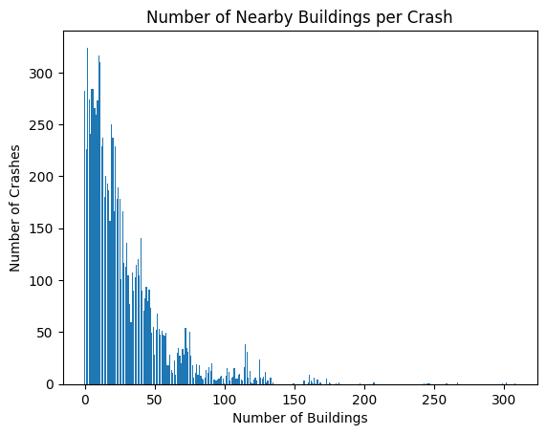
Distribution of Crashes with Nearby Buildings
The plot shows how many crashes occur based on the number of nearby buildings. Clearly there is a skew towards more crashes happening when there are fewer government buildings nearby.

Slide 27
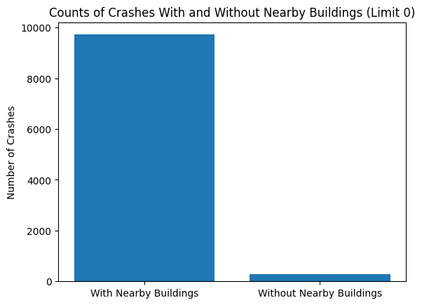
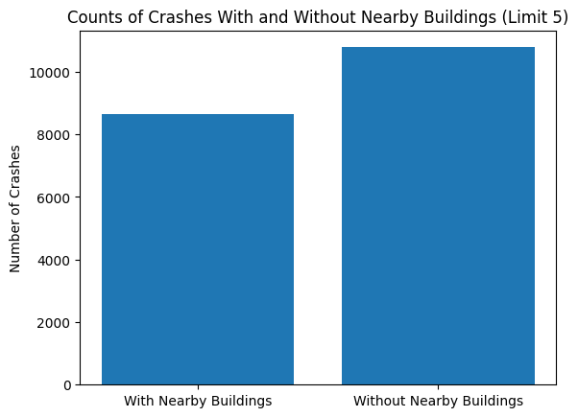
Distribution of Crashes with Nearby Buildings
The below plots show the difference between having a hard limit of 0 nearby buildings as opposed to allowing 5 nearby buildings to count as a soft “without” crash.

Slide 28
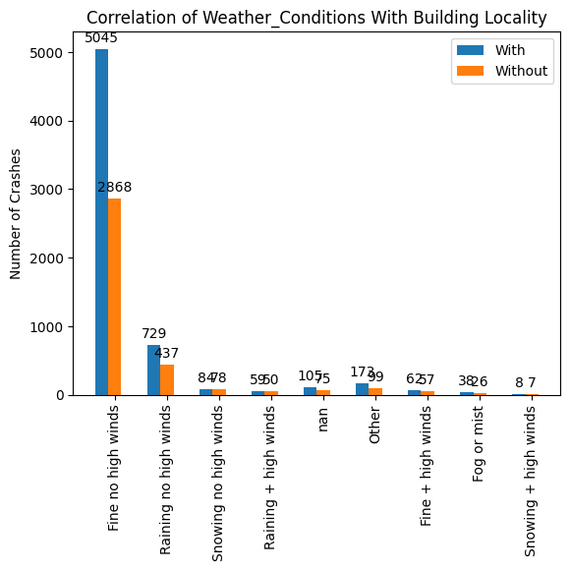
Correlation With Weather
Interestingly most of the crashes occured when there was no concerning weather. As is expected there is less disparity when there is poor weather, but it was expected that worse weather would equal more crashes.

Slide 29
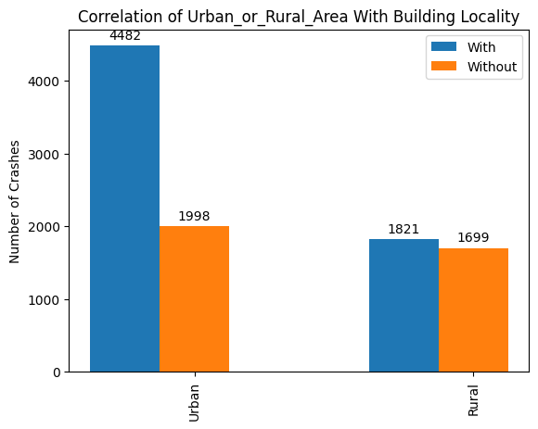
Urban vs. Rural Roads
Driving on roads in a rural area seems to decrease the chances of crashing near a government building, but only to a breaking even point.

Slide 30
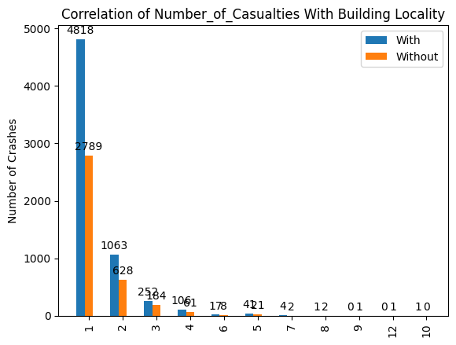
Casualties
Crashes with casualties seem to have significantly higher rates of being close to government buildings.

Slide 31
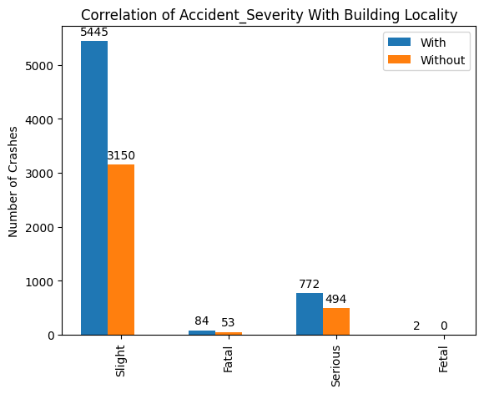
Accident Severity
Fortunately, crashes near government buildings are far more likely to be minor.

Slide 32
References
Department for Transportation, U. (2020, September 30). Reported road casualties in Great Britain: 2019 annual report. UK Government Statistical Release. https://assets.publishing.service.gov.uk/government/uploads/system/uploads/attachment_data/file/922717/reported-road-casualties-annual-report-2019.pdf
World Health Organization. (2023). Road traffic injuries. World Health Organization. https://www.who.int/news-room/fact-sheets/detail/road-traffic-injuries#:~:text=Approximately%201.19%20million%20people%20die%20each%20year%20as,countries%20have%20around%2060%25%20of%20the%20world%27s%20vehicles.
Car crashes in the UK: https://www.kaggle.com/datasets/nextmillionaire/car-accident-dataset.
Housing prices data set: https://www.kaggle.com/datasets/hm-land-registry/uk-housing-prices-paid.
Buildings Dataset: https://www.data.gov.uk/dataset/22e2c169-a0ac-4460-8a06-add54cdc4aee/building.
Image1: https://www.google.com/url?sa=i&url=https%3A%2F%2Fwww.government.nl%2Ftopics%2Fbrexit%2Fquestion-and-answer%2Fwhich-countries-make-up-the-united-kingdom&psig=AOvVaw0klXSis26lGAQSdiskcpNo&ust=1714530915661000&source=images&cd=vfe&opi=89978449&ved=0CBQQjhxqFwoTCPCH1cPz6IUDFQAAAAAdAAAAABAE

